Slide 1
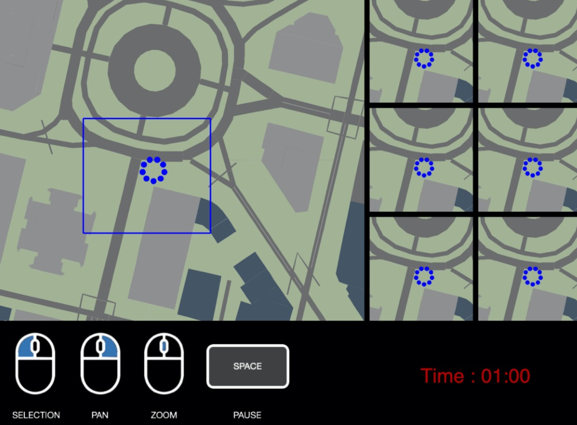
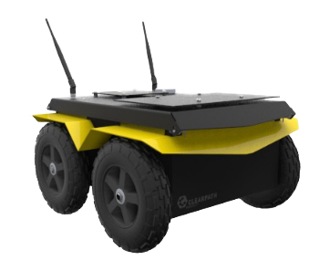
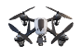
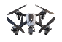
Visualization
Individual
Platoon Abstraction
User’s selection
Platoon
Main GUI
User Controls
OpenAI Gym Interface
(a)
(b)
Swarm Simulator

